Slide 1
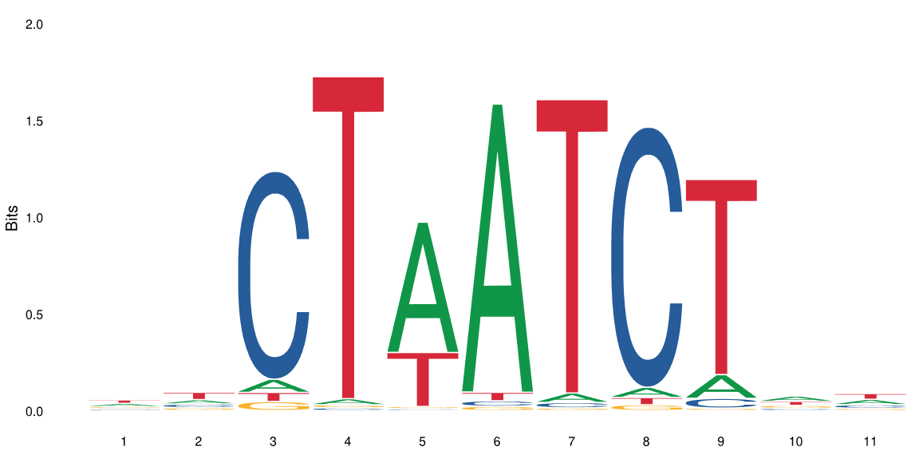
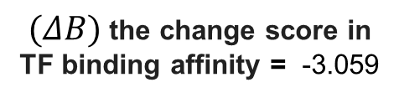
GATA1 Motif
Loss of Function
$(ΔB)$ the change score in TF binding affinity = -3.059
Adj-p value = 4.10e-35
Position
REF:
T T C T T A T C T G A
T T C T T A G C T G A
ALT:
Sample ID: PD3904a
Adj-p value = 3.10e-05

Slide 2
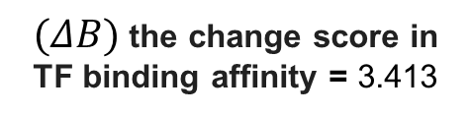
GATA1 Motif
Gain of Function
$(ΔB)$ the change score in TF binding affinity = 3.413
Adj-p value = 3.98e-56
Position
REF:
G T C G T A T C T G A
G T C T T A T C T G A
ALT:
Sample ID: PD3904a

Slide 3
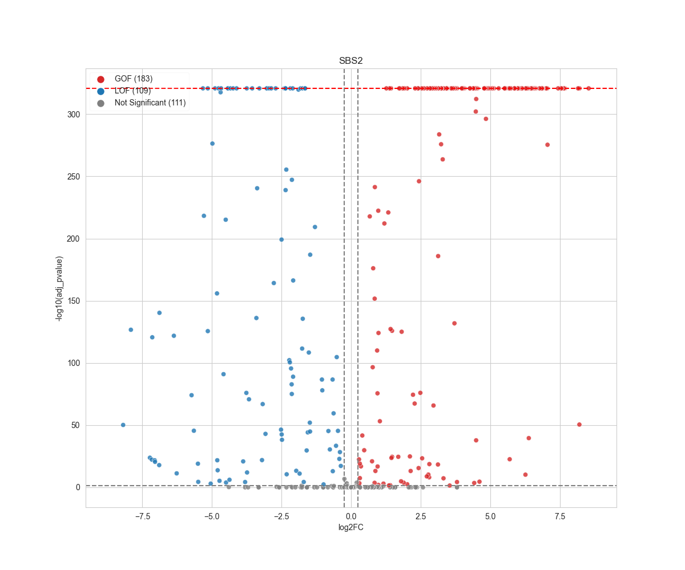
MYPOP
TERF2
MYBL2
DNAJC21
ZZZ3
CRAMP1L

Slide 4
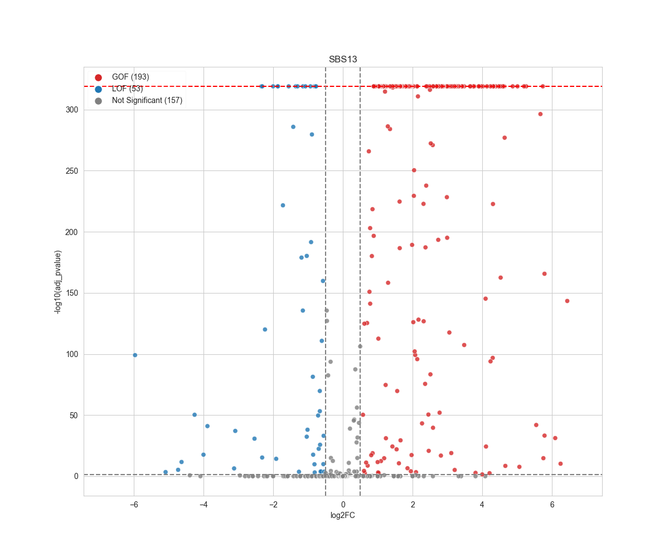
MYBL2
DNAJC21
MYPOP
CRAMP1L
ZZZ3
TERF2

Slide 5
FOXN4
FOXG1
FOXR1
FOXC1
FOXM1
FOXO3
FOXB2
FOXB1
FOXP1
FOXS1
FOXJ2
FOXP4
FOXA3
FOXK1
FOXC2
FOXN3
FOXN2
FOXA1
FOXA2
FOXN1

Slide 6
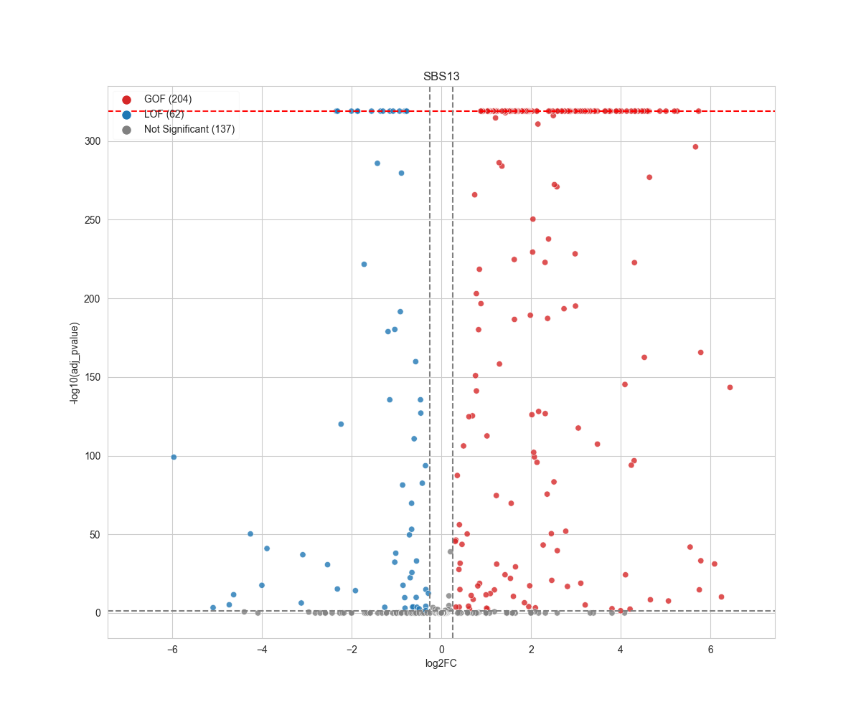
FOXN4
FOXG1
FOXK1
FOXC1
FOXO3
FOXP1
FOXB2
FOXN1
FOXR1
FOXC2
FOXA3
FOXS1
FOXP4
FOXJ2
FOXB1
FOXN3
FOXM1
FOXN2
FOXA2
FOXA1

